Slide 1
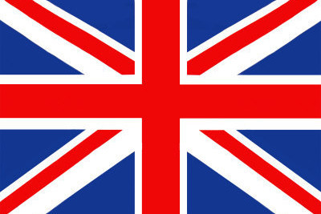
Famous places in UK

Slide 2
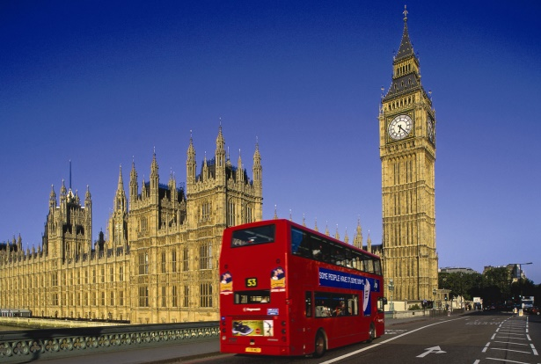
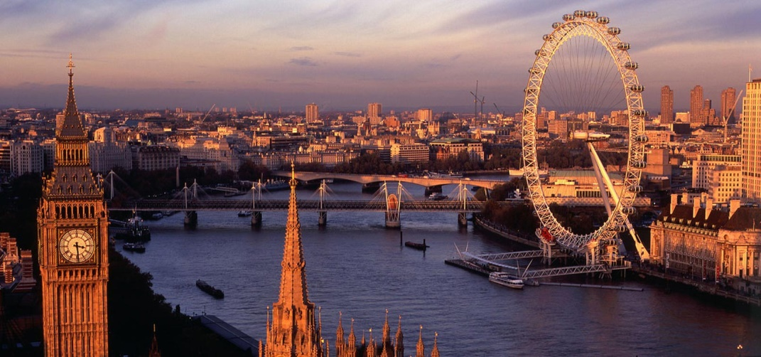
LONDON
London is the capital and most populous city of England and the United Kingdom. It is also one of the largerst cities in Europe. There are a lot of intersting and beautiful places to see. The most famous are British Museum, Trafalagar Square, Nelson´s Column, Buckingham Palace,Westminster Abbey and many more.

Slide 3
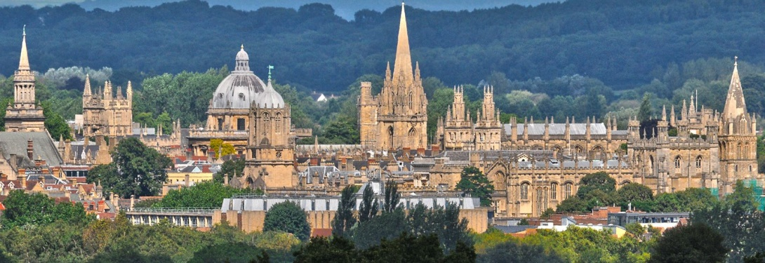
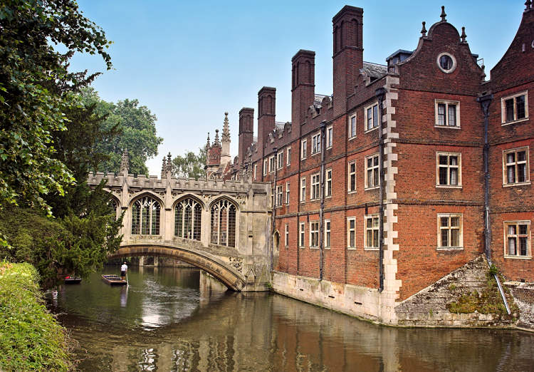
OXFORD AND CAMBRIDGE
Oxford and Cambridge are both universities in England and they both are famous all over the world. Oxford is the oldest university in the English-speaking world and the world's second-oldest surviving university. It grew rapidly from 1167 when Henry II banned English students from attending the University of Paris. After disputes between students and Oxford townsfolk in 1209, some academics fled northeast to Cambridge where they established what became the University of Cambridge. Cambridge is the second oldest university in the English-speaking world and the world's fourth-oldest surviving university. The two "ancient universities" are frequently jointly referred to as "Oxbridge".

Slide 4
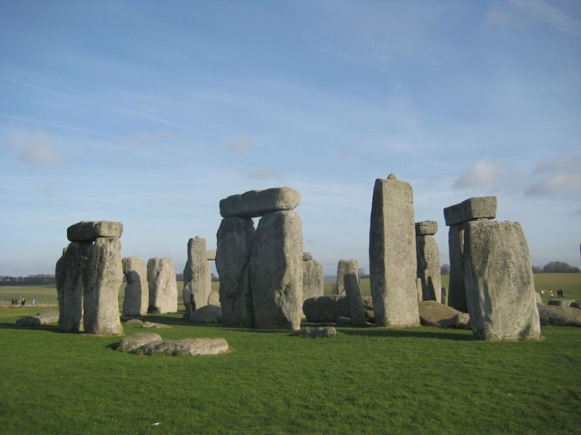
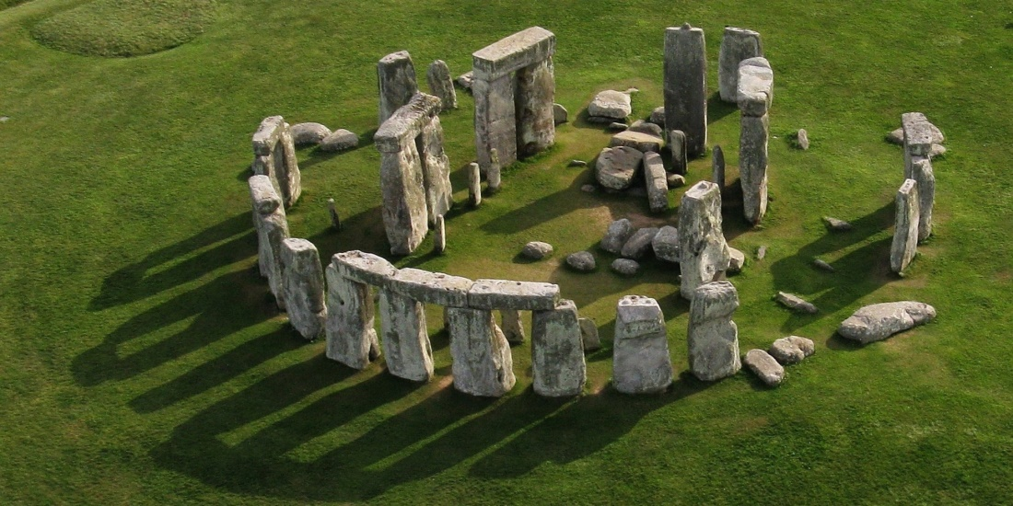
STONEHENGE
This place is considered to be one of the most famous sites in the world. Archaeologists believe that this place was created from 3000 BC to 2000 BC. It was added to the UNESCO’s list of World Heritage Sites in 1986 and some studies released in 2008 stated that Stonehenge may have been a burial ground in the past.

Slide 5
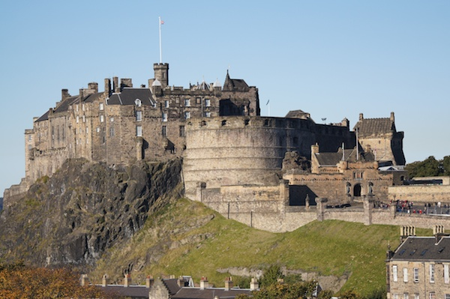
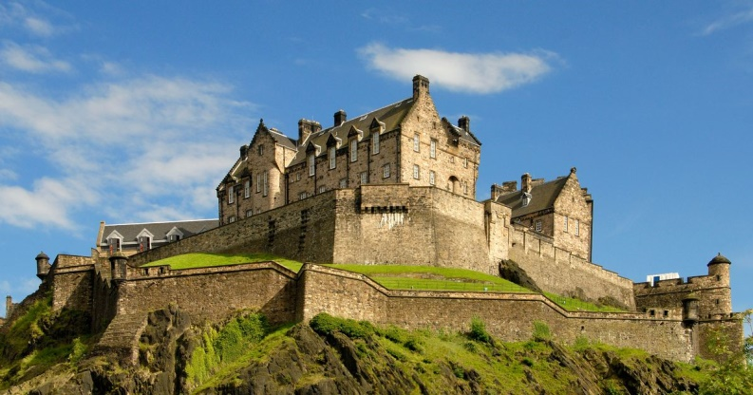
EDINBURH CASTLE
Edinburgh Castle is a majestic fortress built atop a basalt rock called Castle Rock. It is a symbol of Scotland's capital city Edinburgh. Castle Rock formed after a volcano erupted over 340 million years ago. The first castle that existed on the rock was known as “The Castle of the Maidens”. According to legend, the castle had been a shrine to the “Nine Maidens”.

Slide 6
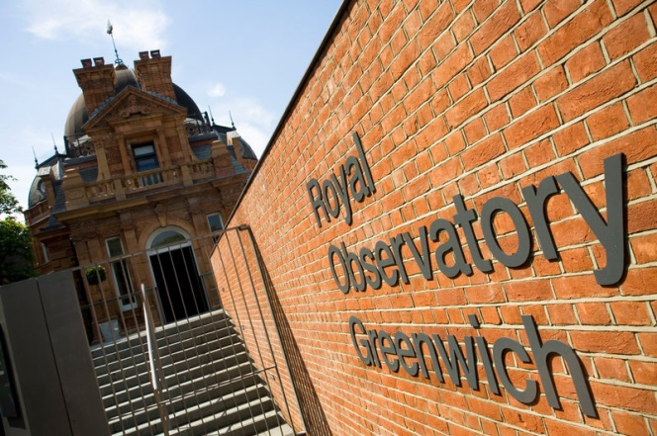
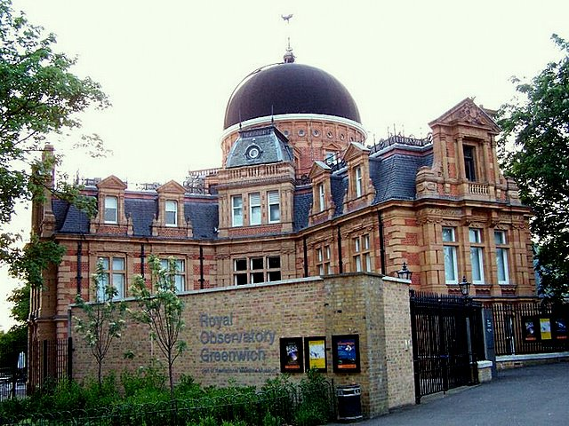
ROYAL OBSERVATORY GREENWICH
This place has played a significant role in the history of navigation and astronomy. It is located on the hill in Greenwich Park, and is overlooking the River Thames. The Royal Observatory has been commissioned by King Charles II. The place is currently being maintained in the UK as a tourist attraction.The two clocks in the area were built by Thomas Tompion and were installed in the principal room of the building.

Slide 7
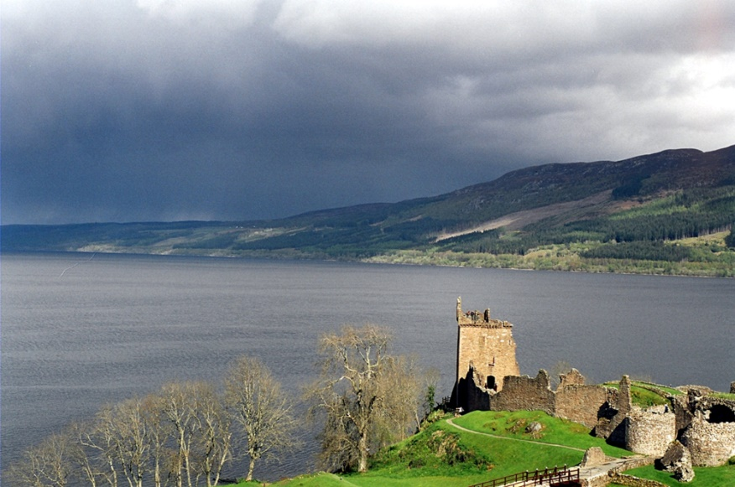
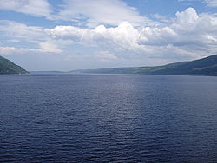
LOCH NESS
is a large, deep, freshwater loch. Loch Ness is best known for alleged sightings of the cryptozoological Loch Ness Monster, also known affectionately as "Nessie".Loch Ness is the second largest Scottish loch by surface area at 22 sq mi (56 km2).

Slide 8
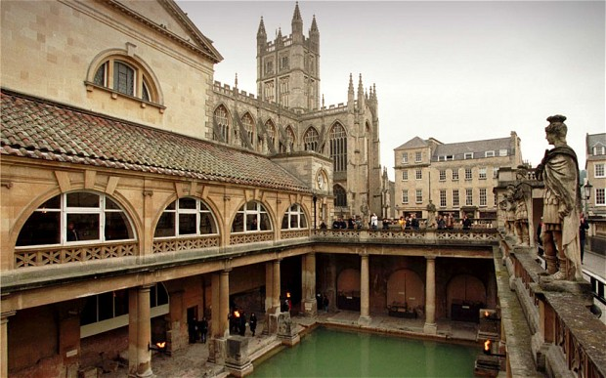
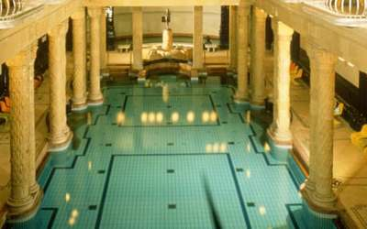
ROMAN BATHS
The Roman Baths give visitors the ability to still see how public bathing was done in the 19th century. Guests can check out the Sacred Spring, the Roman Temple, the Roman Bath House, and the other buildings on its street level however, the bath themselves are located below the modern street level.

Slide 9
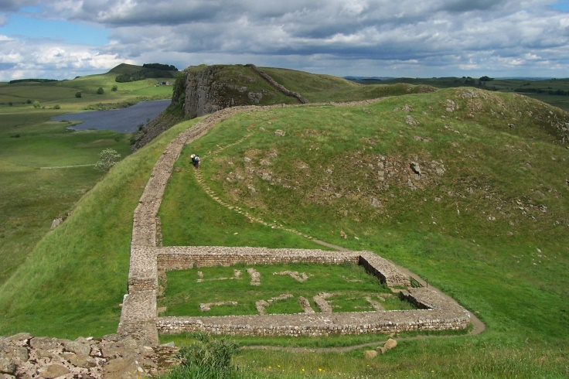
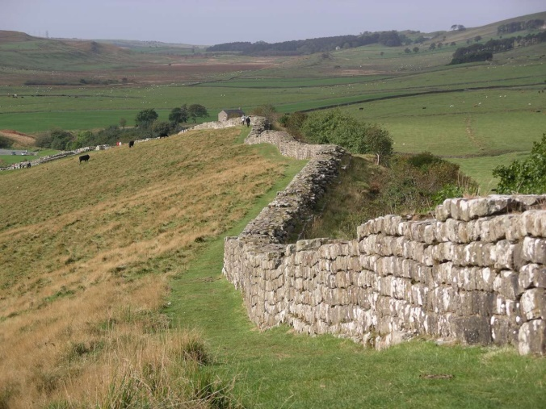
HADRIAN´S WALL
This place was once a defensive fortification in Roman Britain. They begun constructing the area in AD 122, during the time of Emperor Hadrian. The region served as a military fortification, a customs post, and levy taxation area. Visitors are still able to see a significant portion of the wall that has been rescued through the efforts of John Clayton during the 19th century.

Slide 10
MADAME TUSSAUD´S WAX MUSEUM
A famous wax museum in London that has branches in different major cities, it was created by wax sculptor Marie Tussaud. It contains the lifelike likenesses of historical and royal figures, film stars, models, sports stars and infamous murderers. Marie Tussaud was able to model famous people like Jean-Jacques Rousseau and Benjamin Franklin during their time. She was even able to model prominent victims in the French Revolution and made wax models of decapitated heads

Slide 11
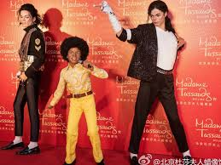
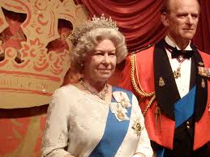

Slide 12
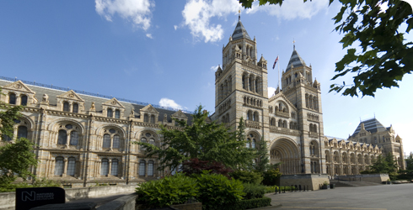
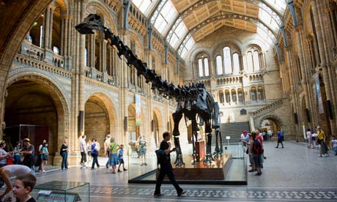
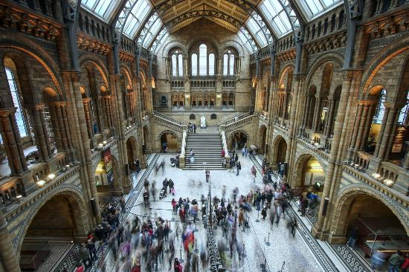
NATURAL HISTORY MUSEUM
It was officially known as the British Museum until 1992. It is the home of life and earth science specimens that range over to over 70 million items. Visitors can see collections related to mineralogy, paleontology, zoology, and entomology.

Slide 13
Thank you for your attention! ☺☻
Lucia Safková
Klaudia Vargošková

